Slide 1

HTTP JSON API Node.js Time Server
Process Documentation

Slide 2
Brief Overview of the Project Process:
The project entails creating an HTTP JSON API Node.js Time Server.
The main aim of this project is to develop a server that can process HTTP requests, interpret JSON data, and provide pertinent time-related data.

Slide 3
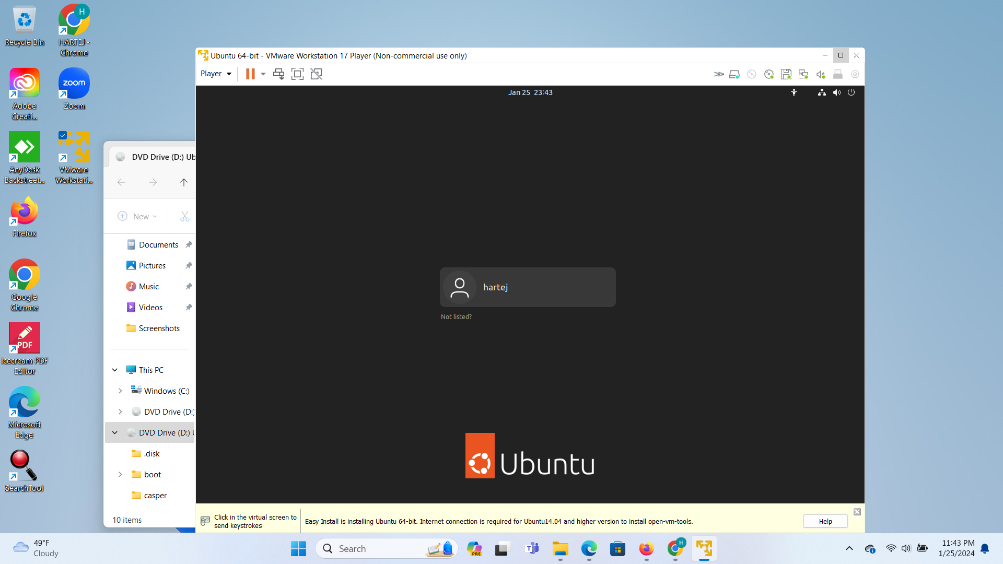
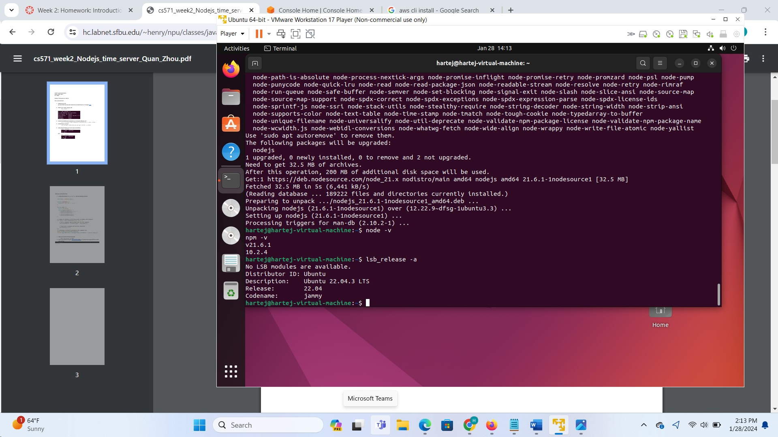
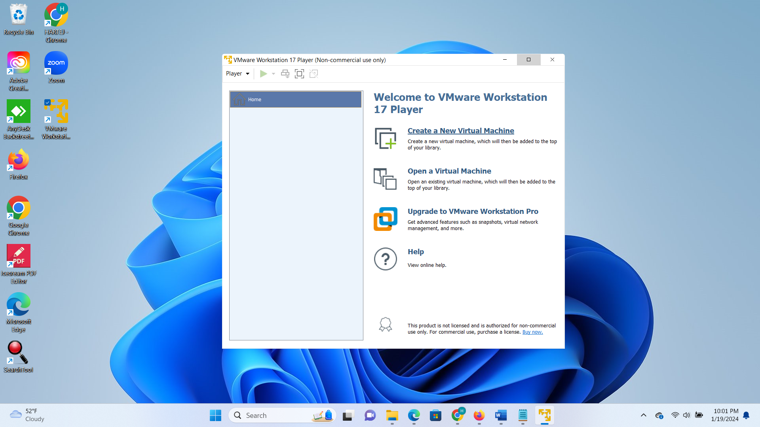
Steps Involved in Setting Up and Studying the Time Server:
Step1. Install Ubuntu on Vmware
Check version of Ubuntu on Server
Step2. Install Node.js on the Ubuntu Vm to enable JavaScript runtime for server-side applications.
Install Node.js on Ubuntu Vm :
Check version of Node and Nmp
Node.js provides a platform for building scalable network applications and is essential for running the Time Server.

Slide 4
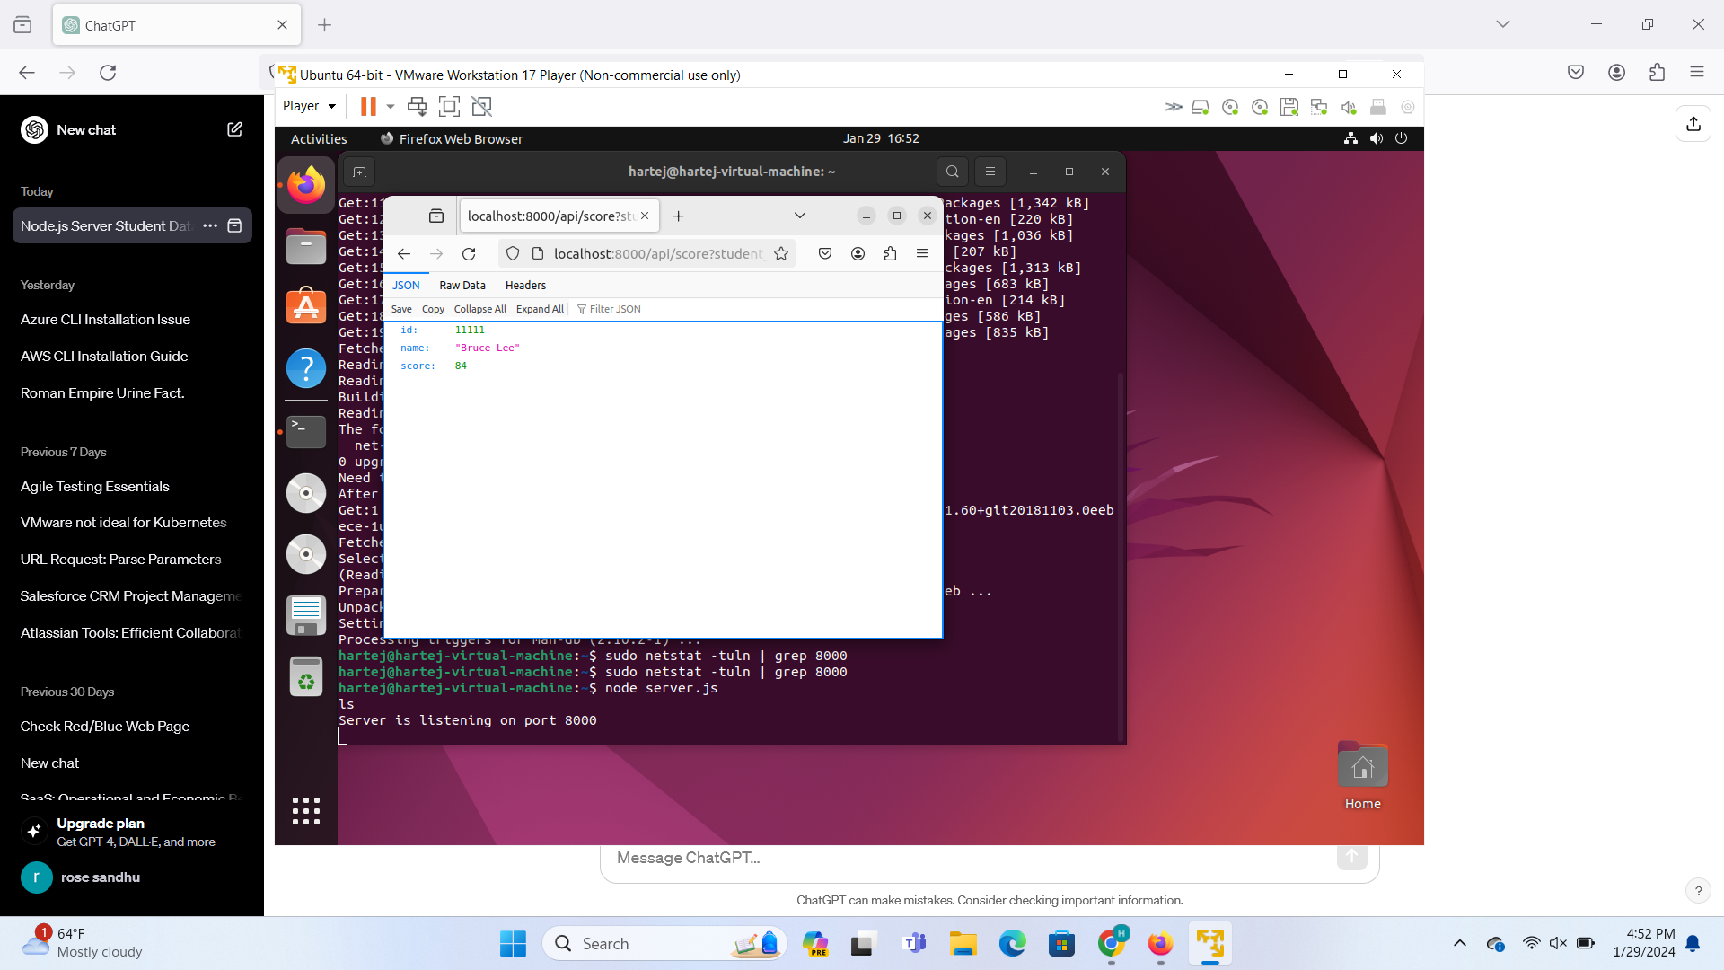
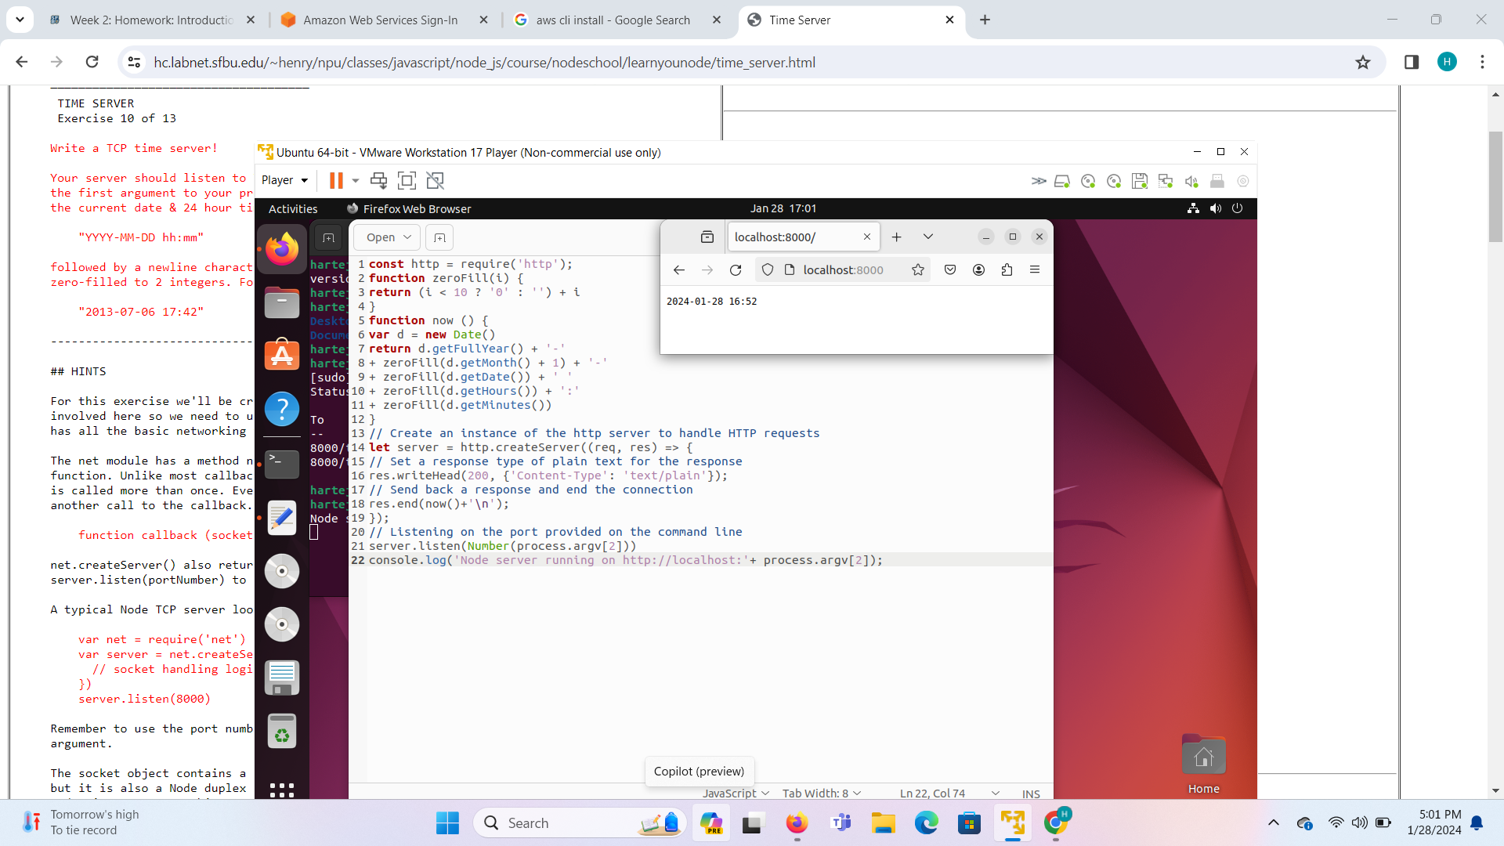
Step 3: Time Server:
Study the Time Server implementation to understand its architecture, functionalities, and how it handles time-related requests.
Analyze the codebase, including server configuration, routing, and handling of HTTP requests and responses.

Slide 5
Step 4: JSON:
JSON (/.d.e.s.n/ jay-sawn, /.d.e.s.n/ jay-sun), or JavaScript Object Notation, is a text-based open standard designed for human-readable data interchange.
Derived from the JavaScript scripting language, JSON is a language for representing simple data structures and associative arrays, called objects.
Despite its relationship to JavaScript, JSON is language-independent, with parsers available for many languages.
JSON vs XML
Choose JSON for:
Simplicity and speed
Data exchange and APIs
Configuration files with basic structures
Choose XML for:
Complex data structures
Self-describing documents
Validation and data integrity

Slide 6
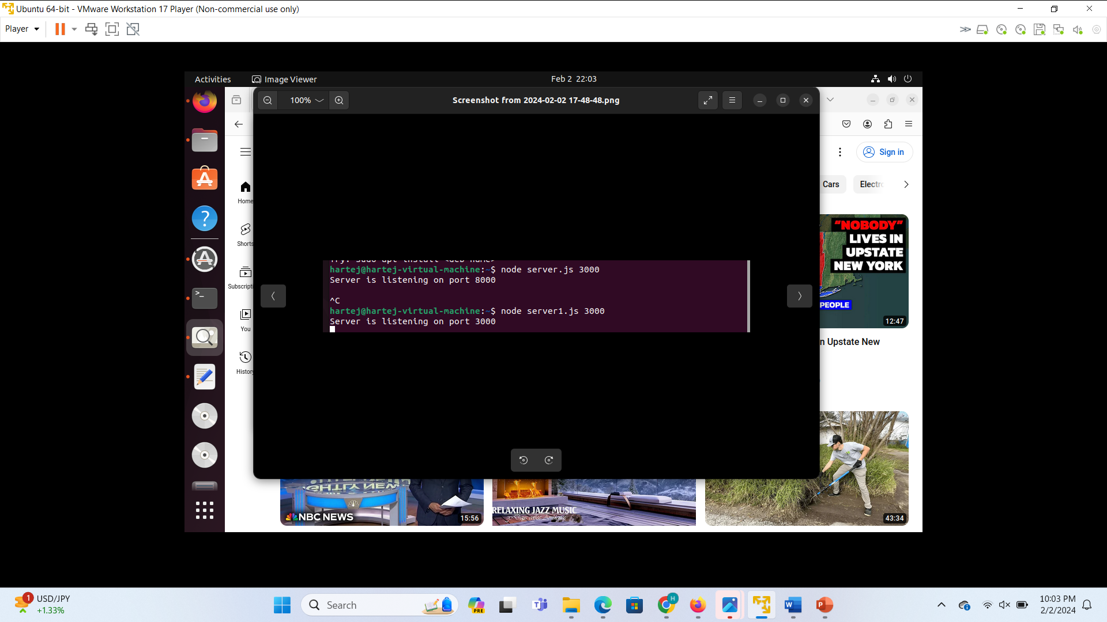
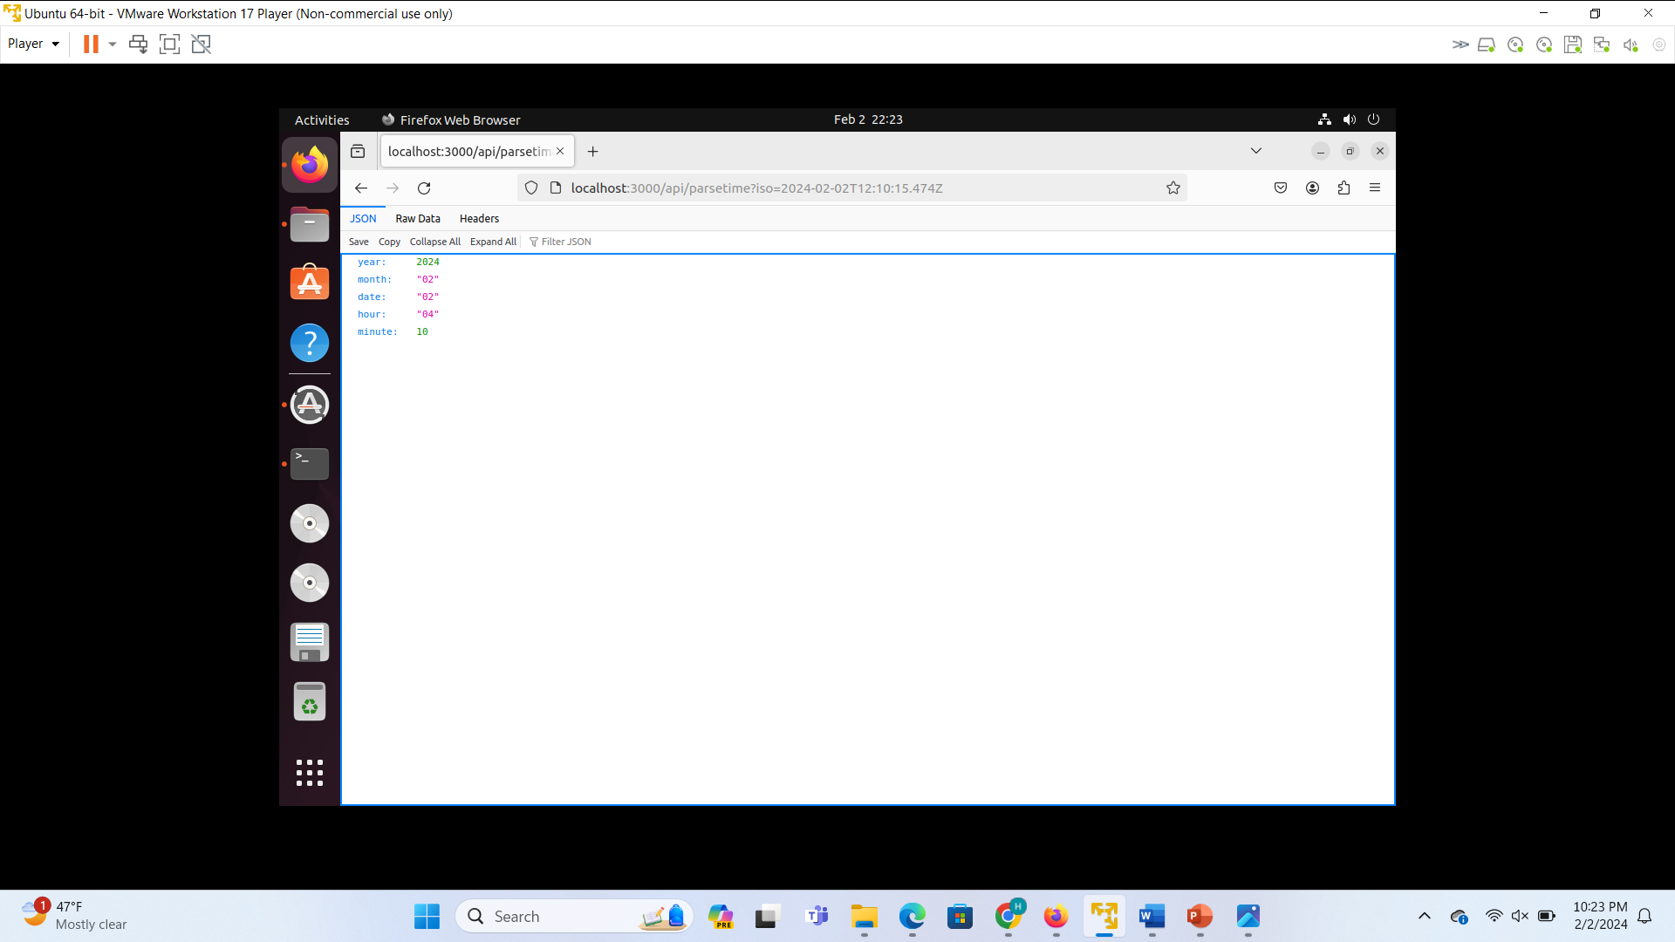
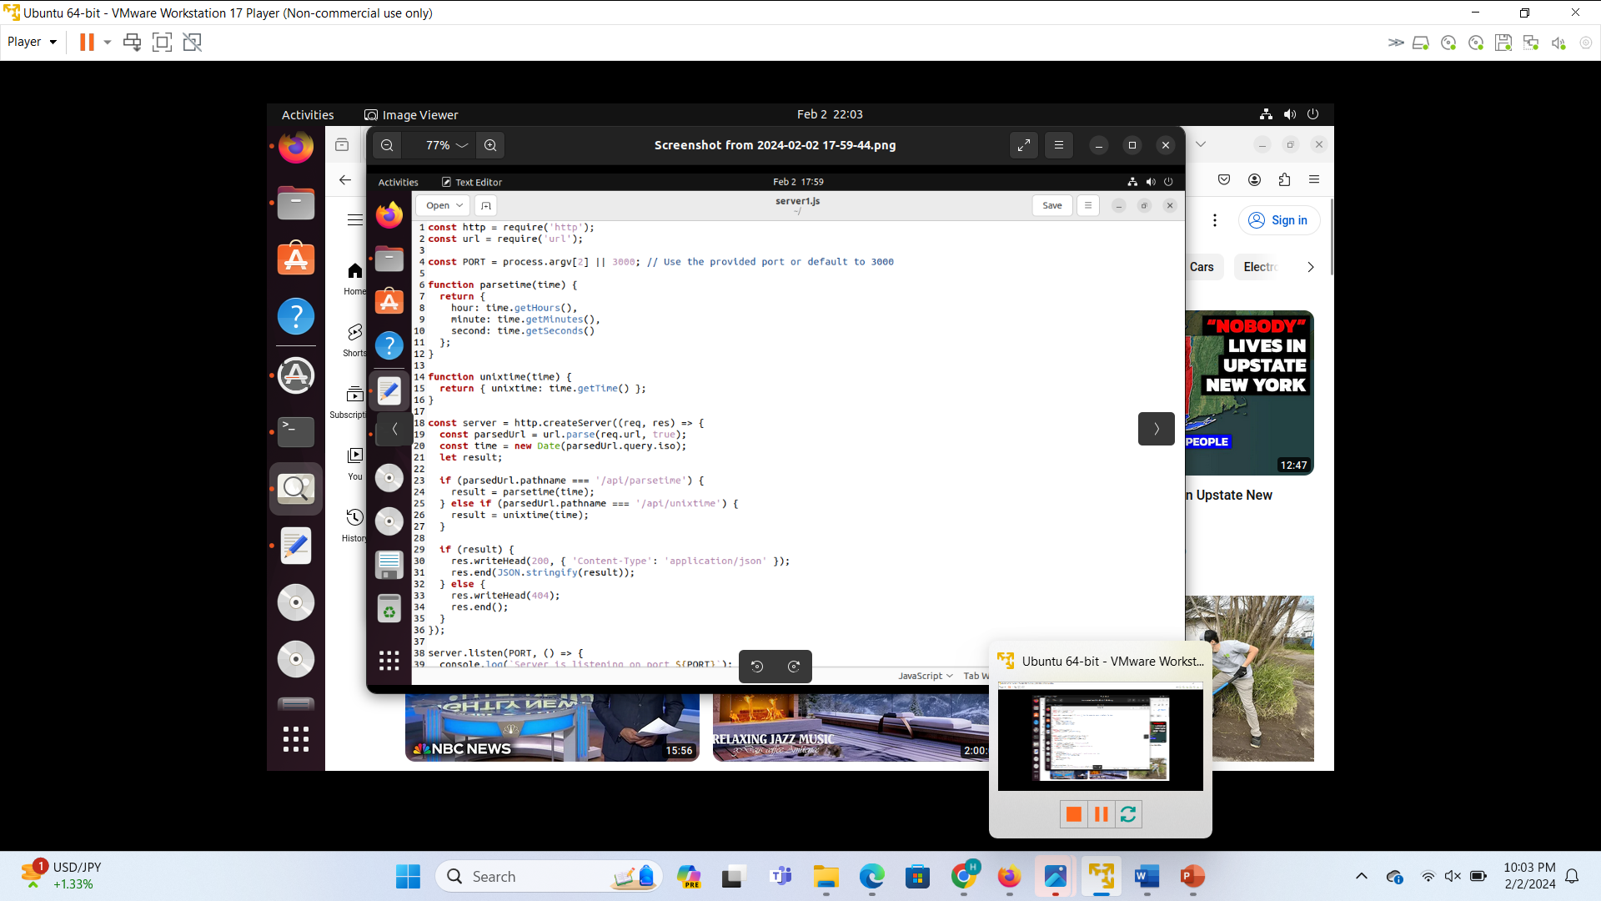
Step 5: HTTP JSON API Server:
Learn about HTTP (Hypertext Transfer Protocol) and how it enables communication between clients and servers over the web.
Study the concept of JSON APIs (Application Programming Interfaces) and how they allow clients to interact with server resources using JSON-formatted data.

Slide 7
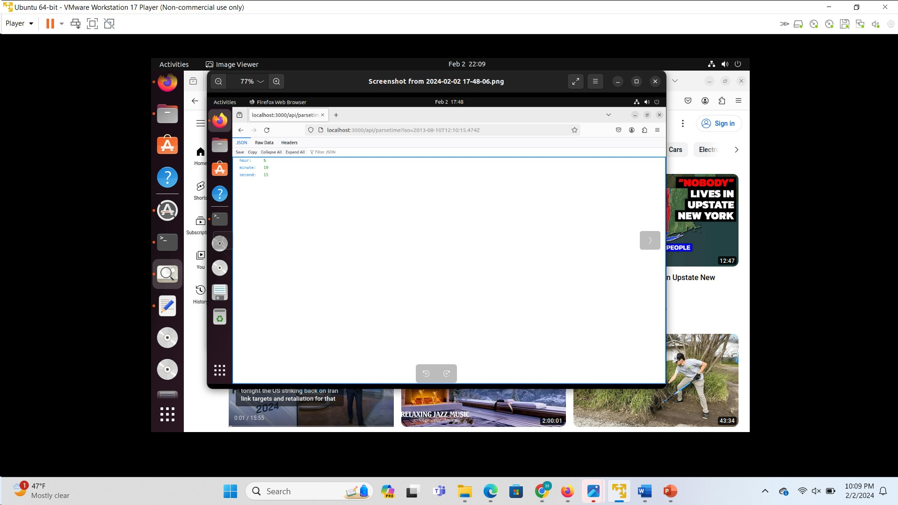
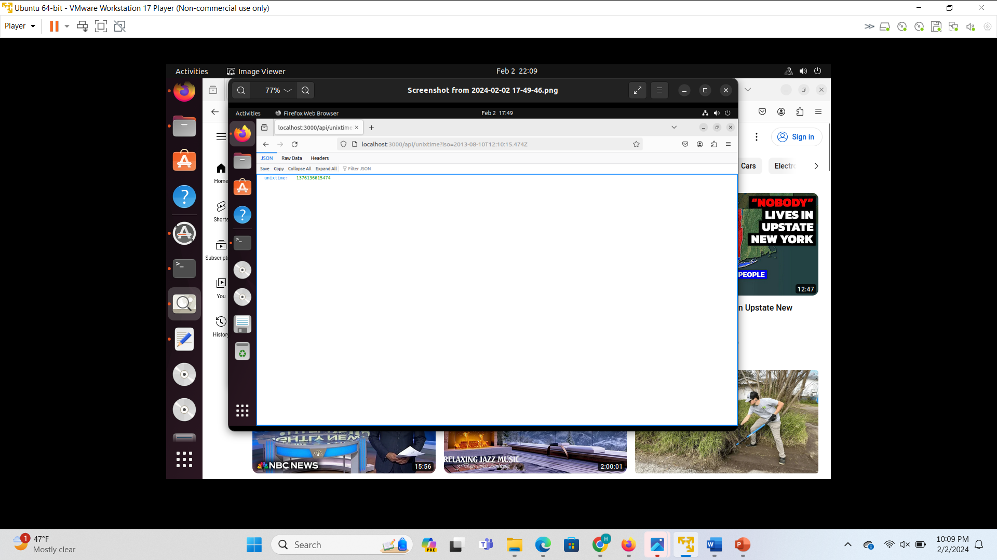
Step 6: Modify HTTP JSON API Server to support this request from the client side:
Implement modifications to the HTTP JSON API Server to support a specific client request.
Update the server logic to handle incoming requests for current time information and respond with JSON data containing year, month, date, hour, and minute properties.
Step 1: On the server $ node http_json_api_server.js 8000
Step 2: on the client browser http://localhost:8000/api/parsetime?iso=2013-08-10T12:10:15.474Z The browser displays {"hour":5,"minute":10,"second":15}
Step 3: on the client browser http://localhost:8000/api/unixtime?iso=2013-08-10T12:10:15.474Z The browser displays {"unixtime":1376136615474}

Slide 8
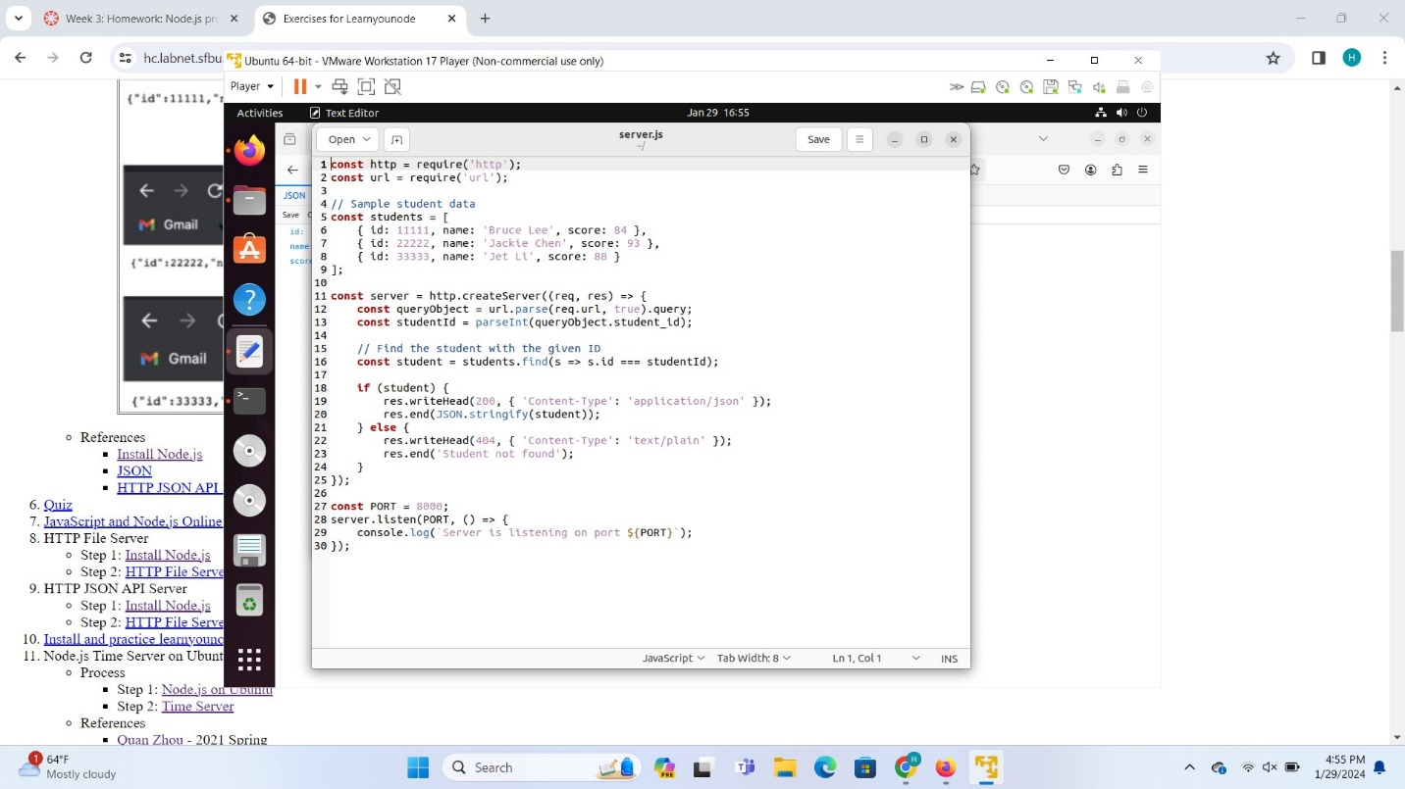
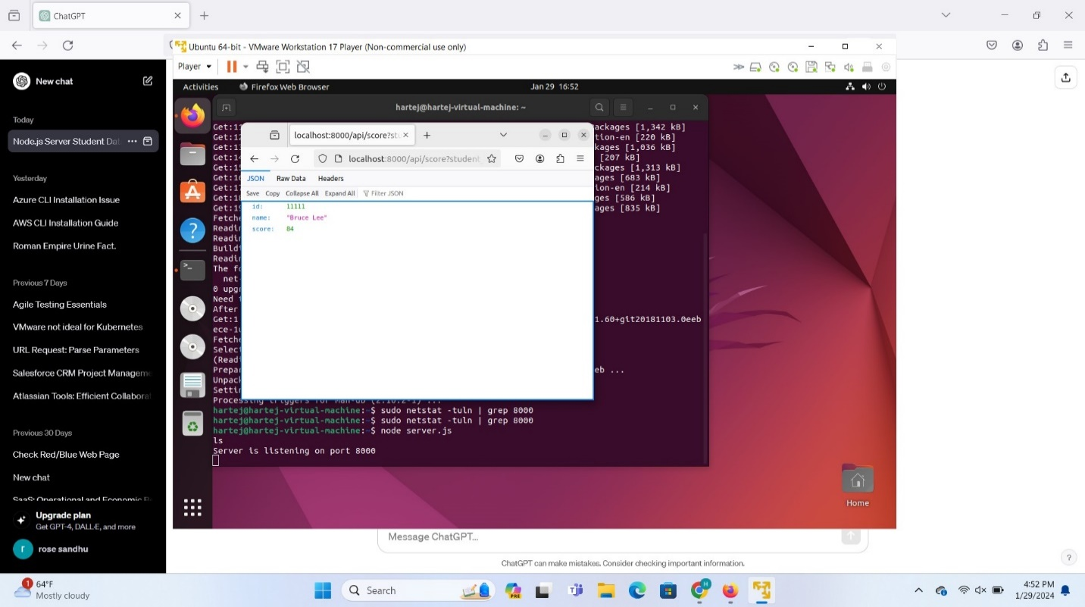
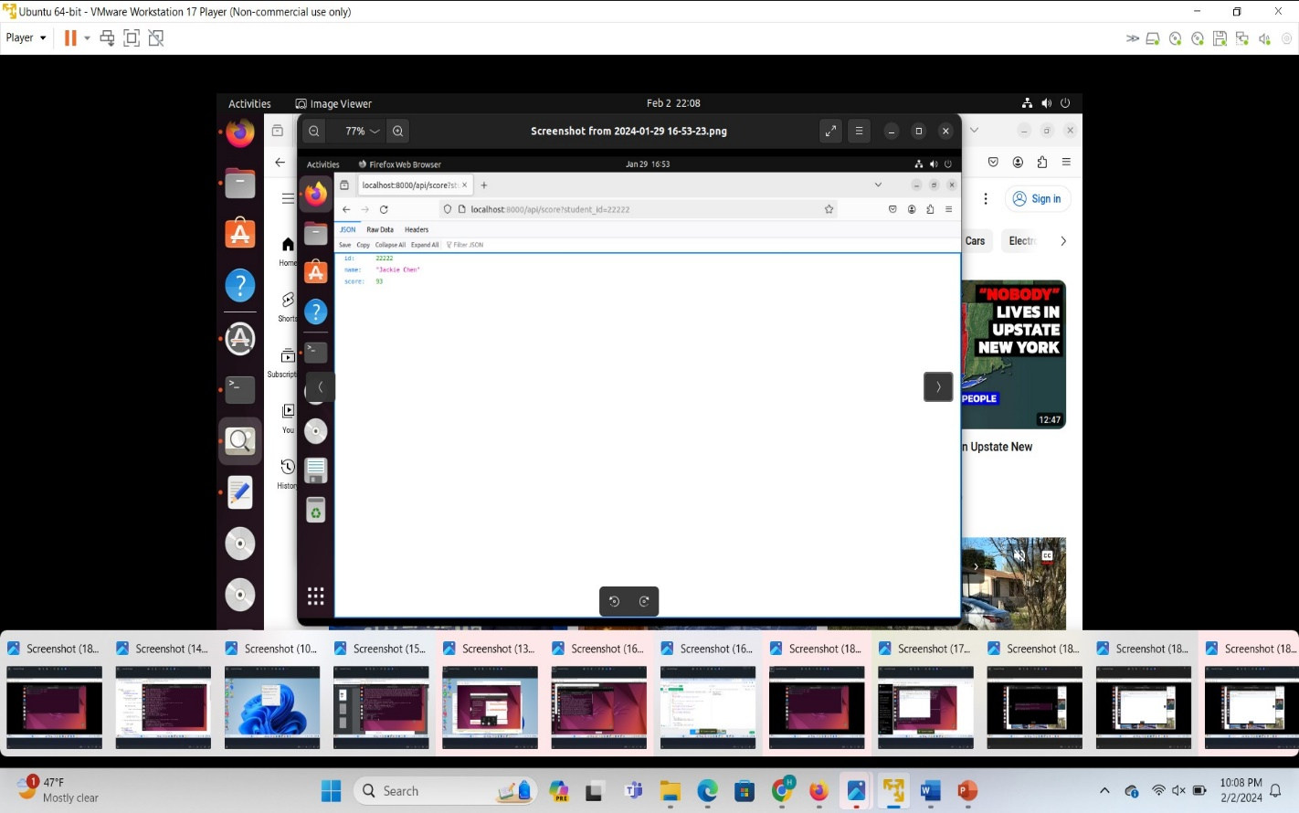

Send JSON data from node.js server: student info
JavaScript to let a node.js server send data to the client.
JavaScript is a high-level, dynamic programming language that plays a crucial role in making web pages interactive and engaging. It's one of the core technologies, alongside HTML and CSS, forming the foundation of the modern web.

Slide 9
References:
https://hc.labnet.sfbu.edu/~henry/npu/classes/javascript/node_js/course/nodeschool/learnyounode/exercise_learnyounode.html

